Slide 1

Data Science Fundamentals
Lecture Slides for
Dr. Diaa Salama

Slide 2
Data Science Process?
The methodology Life Cycle to deliver predictive analytics solutions and intelligent applications efficiently.
helps improve team collaboration and learning by suggesting how team roles work best together.
This Data Science project life cycle and its main components by provide a generic description of the process here that can be implemented with different kinds of tools.
A more detailed description of the project tasks and roles involved in the lifecycle of the process is provided.

Slide 3
Data science lifecycle
provides a lifecycle to structure the development of your data science projects.
The lifecycle outlines the major stages that projects typically execute, often iteratively:
Business Understanding
Data Acquisition and Understanding
Modeling
Deployment

Slide 4
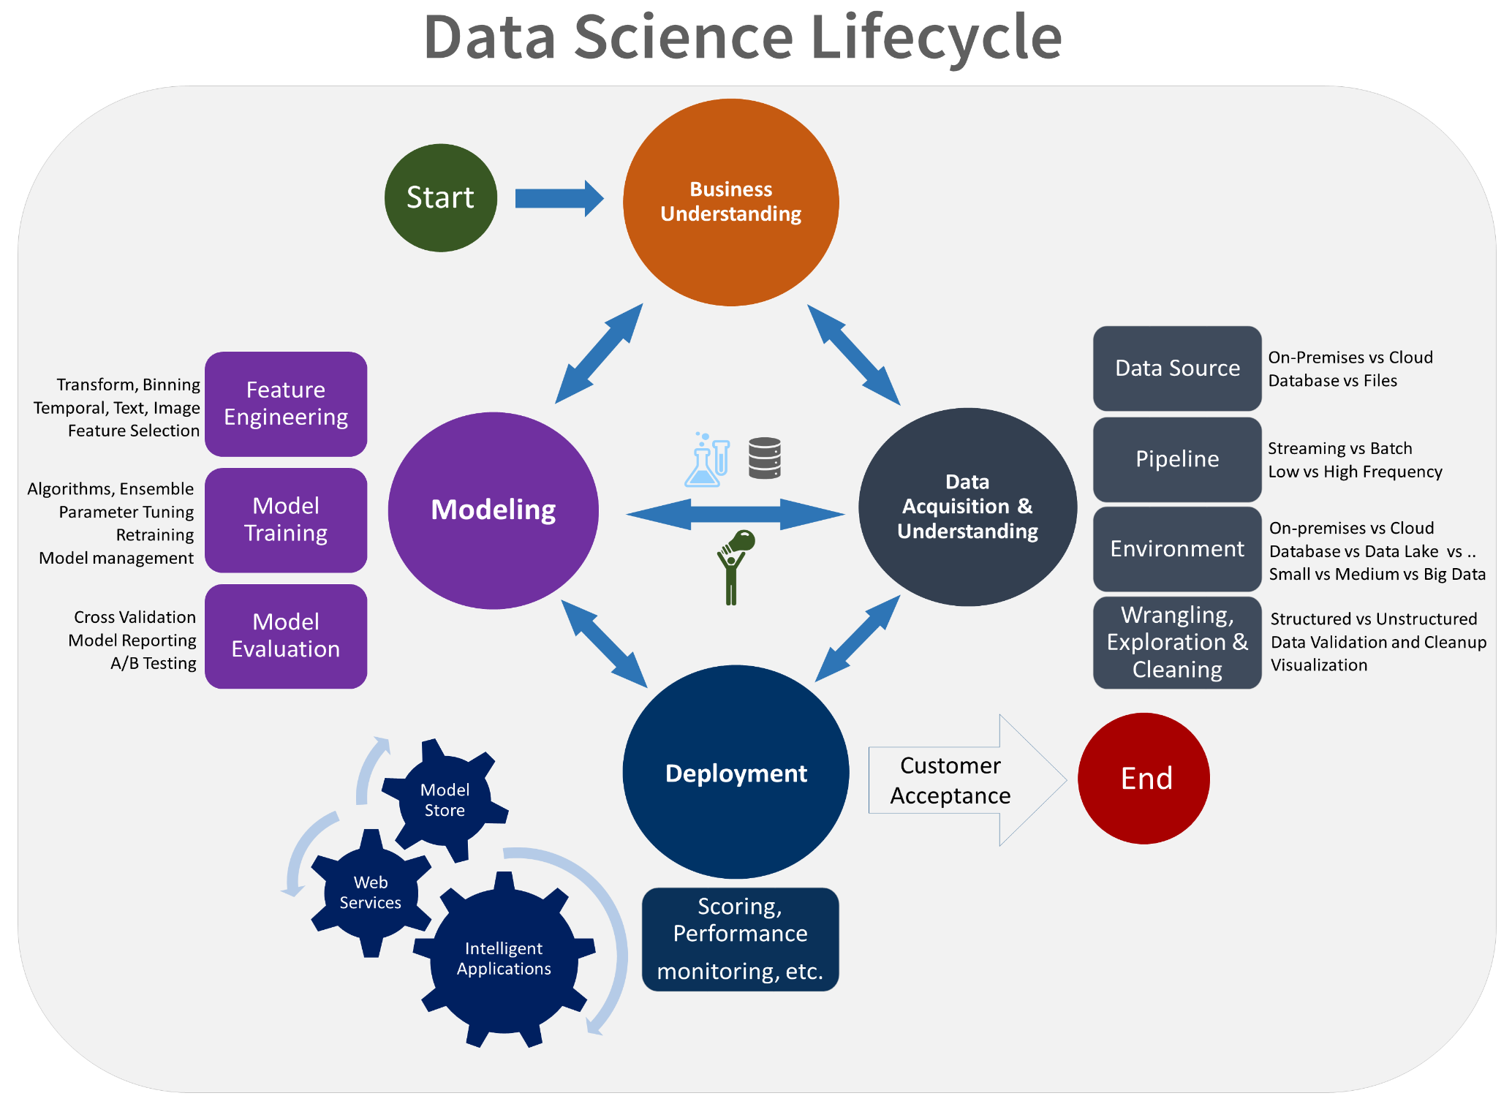
Data science lifecycle

Slide 5
1st stage :The business understanding
Goal of The business understanding stage
Specify the key variables that are to serve as the model targets
Identify the relevant data sources (needs to obtain).

Slide 6
1st stage :The business understanding
(Objective) There are two main tasks addressed in this stage:
Define objectives: Work with your customer and other stakeholders to understand and identify the business problems. Formulate questions that define the business goals that the data science techniques can target.
Identify data sources: Find the relevant data that helps you answer the questions that define the objectives of the project.

Slide 7
Cont. 1st stage :The business understanding (Define objectives)
Define the project goals by asking and refining "sharp" questions that are relevant, specific, and unambiguous. Data science is a process that uses names and numbers to answer such questions. You typically use data science or machine learning to answer five types of questions:
How much or how many? (regression)
Which category? (classification)
Which group? (clustering)
Is this weird? (anomaly detection)
Which option should be taken? (recommendation)
Determine which of these questions you're asking and how answering it achieves your business goals.

Slide 8
Cont. 1st stage :The business understanding (Identify data sources)
Identify data sources that contain known examples of answers to your sharp questions.
Data that's relevant to the question.
you might find that the existing systems need and achieve the project goals. In this situation, you might want to look for external data sources or update your systems to collect new data to collect and log additional kinds of data to address the problem

Slide 9
2nd stage :Data acquisition and understanding
Goals
Locate the data set in the fitting analytics environment so you are ready to model.
Produce a clean, high-quality data set whose relationship to the target variables is understood.
Develop a solution architecture of the data pipeline that refreshes and scores the data regularly.

Slide 10
2nd stage :Data acquisition and understanding
Objective There are three main tasks addressed in this stage:
Ingest the data into the target analytic environment.
Explore the data to determine if the data quality is acceptable to answer the question.
Set up a data pipeline to score new or regularly refreshed data.

Slide 11
2nd stage :Data acquisition and understanding
Ingest the data
move the data from the source locations to the target locations where you run analytics operations, like training and predictions.
Explore the data
Before you train your models, you need to develop understanding of the data. Real-world data sets are often noisy, have missing values, or have a host of other discrepancies. You can use data summarization and visualization to audit the quality of your data before it's ready for modeling.
Set up a data pipeline
In addition to the initial ingestion and cleaning of the data, you typically need to set up a process to score new data or refresh the data regularly as part of an ongoing learning process.

Slide 12
3rd stage : Modeling
Goals
Determine the optimal data features for the machine-learning model.
Create an informative machine-learning model that predicts the target most accurately.
Create a machine-learning model that's suitable for production.

Slide 13
3rd stage : Modeling
There are three main tasks addressed in this stage:
Feature engineering
Model training
Evaluate

Slide 14
3rd stage : Modeling
There are three main tasks addressed in this stage:
Feature engineering: Create data features from the raw data to facilitate model training.
Feature engineering is a balancing act of finding and including informative variables, but at the same time trying to avoid too many unrelated variables.
Informative variables improve your result; unrelated variables introduce unnecessary noise into the model. You also need to generate these features for any new data obtained during scoring. As a result, the generation of these features can only depend on data that's available at the time of scoring.

Slide 15
3rd stage : Modeling
There are three main tasks addressed in this stage:
Model training: Find the model that answers the question most accurately by comparing their success metrics. Depending on the type of question that you're trying to answer, there are many modeling algorithms available.
Split the input data randomly for modeling into a training data set and a test data set.
Build the models by using the training data set.
Evaluate the training and the test data set. Use a series of competing machine-learning algorithms along with the various associated tuning parameters (known as a parameter sweep) that are geared toward answering the question of interest with the current data.
Determine the "best" solution to answer the question by comparing the success metrics between alternative methods.

Slide 16
3rd stage : Modeling
There are three main tasks addressed in this stage:
Model Evaluation: After training, the data scientist focuses next on model evaluation.
Evaluate whether the model performs sufficiently for production. Some key questions to ask are:
Does the model answer the question with sufficient confidence given the test data?
Should you try any alternative approaches?
Should you collect additional data, do more feature engineering, or experiment with other algorithms?

Slide 17
4th stage : Deployment
Goal
Deploy models with a data pipeline to a production or production-like environment for final user acceptance.

Slide 18
4th stage : Deployment
How to do it
The main task addressed in this stage:
Operationalize the model:
After you have a set of models that perform well, you can operationalize them for other applications to consume. Depending on the business requirements, predictions are made either in real time or on a batch basis. To deploy models, you representation them with an open API interface. The interface enables the model to be easily consumed from various applications, such as:
Online websites
Spreadsheets
Dashboards
Line-of-business applications
Back-end applications

Slide 19
5th stage : Customer acceptance
Goal
Finalize project deliverables: Confirm that the pipeline, the model, and their deployment in a production environment satisfy the customer's objectives.

Slide 20
5th stage : Customer acceptance
How to do it
There are two main tasks addressed in this stage:
System validation: Confirm that the deployed model and pipeline meet the customer's needs.
Project hand-off: Hand the project off to the entity that's going to run the system in production.
The customer should validate that the system meets their business needs and that it answers the questions with acceptable accuracy to deploy the system to production for use by their client's application. All the documentation is finalized and reviewed. The project is handed-off to the entity responsible for operations. This entity might be, for example, an IT or customer data-science team or an agent of the customer that's responsible for running the system in production.

Slide 21
Resources: Azure
Team Data Science Process : https://learn.microsoft.com/en-us/azure/architecture/data-science-process/group-manager-tasks

